Slide 1
A core Course on Modeling
Introduction to Modeling
0LAB0 0LBB0 0LCB0 0LDB0
c.w.a.m.v.overveld@tue.nl
v.a.j.borghuis@tue.nl
S.22

Slide 2
Execution phase: operate model
define
formulate
purpose
conceptualize
identify
entities
choose
relations
formalize
obtain
values
formalize
relations
execute
operate
model
obtain
result
conclude
present
result
interpret
result
Notes:
2

Slide 3
Category-I quantities correspond to
free decisions / modifications / explorations / ….
Category-II quantities correspond to things you want.
But what do you want?
http://www.morguefile.com/archive/display/156086
s = distance travelled
t = duration of the tour
v = velocity
W = performed work
F_{w} = wind force
c = constant
A = area
ρ = air density
Notes:
3

Slide 4
Category-I quantities correspond to
free decisions / modifications / explorations / ….
Category-II quantities correspond to things you want.
But what could you want?
http://www.morguefile.com/archive/display/156086
s = distance travelled
t = duration of the tour
v = velocity
W = performed work
F_{w} = wind force
c = constant
A = area
ρ = air density
Notes:
4

Slide 5
Category-I quantities correspond to
free decisions / modifications / explorations / ….
Category-II quantities correspond to things you want
nothing: every choice is good
W minimal: make s=0
s minimal: make s=0
t minimal: make s=0
not very interesting
s = distance travelled
t = duration of the tour
v = velocity
W = performed work
F_{w} = wind force
c = constant
A = area
ρ = air density
Notes:
5

Slide 6
Category-I quantities correspond to
free decisions / modifications / explorations / ….
Category-II quantities correspond to things you want
not very interesting
W minimal and t minimal: s=0
s maximal and t minimal: v→∞
W minimal and s maximal: interesting
W minimal and s maximal and t minimal: interesting
interesting cases involve >1 criterion
...but not the other way round
s = distance travelled
t = duration of the tour
v = velocity
W = performed work
F_{w} = wind force
c = constant
A = area
ρ = air density
Notes:
6

Slide 7
Category-I quantities correspond to
free decisions / modifications / explorations / ….
Category-II quantities correspond to things you want
conclusion:
many optimization problems involve trade-offs
examples:
largest volume with smallest area
largest profit with smallest investment
largest ... with least ...
largest velocity with largest safety
largest ... with largest ... (and other combinations)
also cases with >2 criteria often occur.
http://www.morguefile.com/archive/display/93433
s = distance travelled
t = duration of the tour
v = velocity
W = performed work
F_{w} = wind force
c = constant
A = area
ρ = air density
Notes:
7

Slide 8
Category-I quantities correspond to
free decisions / modifications / explorations / ….
Category-II quantities correspond to things you want
QUIZ
In order to wrap something efficiently, I seek for a shape with maximal volume and minimal area.
In what case could I want a shape with minimal volume and maximal area?
conclusion:
many optimization problems involve trade-offs
examples:
largest volume with smallest area
largest profit with smallest investment
largest ... with least ...
largest velocity with largest safety
largest ... with largest ... (and other combinations)
also cases with >3 criteria often occur.
http://www.morguefile.com/archive/display/93433
s = distance travelled
t = duration of the tour
v = velocity
W = performed work
F_{w} = wind force
c = constant
A = area
ρ = air density
Notes:
8

Slide 9
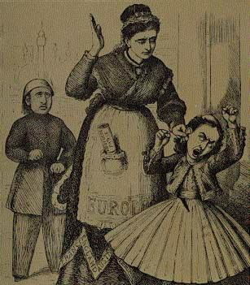
To express criteria, use penalties.
A penalty q = f(cat.-I quantities) is
a cat.-II quantity
a function of cat.-I quantities
≥0 (q=0 is ideal)
should be as small as possible
http://commons.wikimedia.org/wiki/File:Europe_punishes_the_spoilt_kid_(Greece)_for_asking_too_much.jpg
examples:
little effort: q_{W}=|W(t,v)| = W(t,v)
large distance: q_{s}=|s⁻¹(t,v)|
s = distance travelled
t = duration of the tour
v = velocity
W = performed work
F_{w} = wind force
c = constant
A = area
ρ = air density
Notes:
9

Slide 10
To express criteria, use penalties.
multiple criteria: multiple penalties
add: Q= Σ_{i} q_{i} ← only if q_{i} have same dimension
Q= Σ_{i} w_{i} q_{i ,} w_{i}>0← w_{i}q_{i} must have same dimension
weights w_{i}: values ???
if w_{i}’> w_{i}, then q_{i}’ will be smaller than q_{i}
unit of w_{s} is km
unit of w_{w} is Joule⁻¹
examples:
little effort and large distance: Q = w_{w}q_{W}+w_{s}q_{s}
=w_{w} W(t,v)+w_{s}|s⁻¹(t,v)|
little effort and large distance and little time:
Q = w_{w}W(t,v)+w_{s}|s⁻¹(t,v)|+w_{t}t
s = distance travelled
t = duration of the tour
v = velocity
W = performed work
F_{w} = wind force
c = constant
A = area
ρ = air density
unit of w_{t} is hour ⁻¹
Notes:
10

Slide 11
To express criteria, use penalties.
multiple criteria: multiple penalties
add: Q= Σ_{i} q_{i} ← only if q_{i} have same dimension
Q= Σ_{i} w_{i} q_{i ,} w_{i}>0← w_{i}q_{i} must have same dimension
weights w_{i}: values ???
multiple criteria by adding penalties: lumping
advantages:
works for arbitrarily many criteria
may use mathematical techniques
for a single Q = f(cat.-I)
(e.g., differentiate and require derivatives to be 0)
s = distance travelled
t = duration of the tour
v = velocity
W = performed work
F_{w} = wind force
c = constant
A = area
ρ = air density
Notes:
11

Slide 12
To express criteria, use penalties.
multiple criteria: multiple penalties
add: Q= Σ_{i} q_{i} ← only if q_{i} have same dimension
Q= Σ_{i} w_{i} q_{i ,} w_{i}>0← w_{i}q_{i} must have same dimension
weights w_{i}: values ???
multiple criteria by adding penalties: lumping
disadvantages:
what should values for w_{i} be?
adding apples and oranges may be
ethically unwanted
Notes:
12

Slide 13
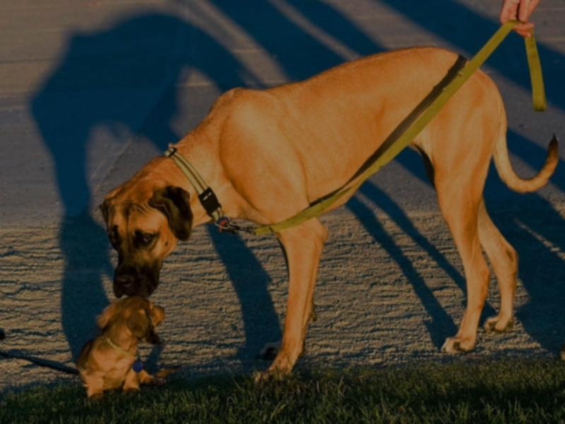
To express criteria, use penalties.
Variations to penalties (y = f(cat.-I quantities)):
q = y: y should be small; assume that y≥0
q = |y| or q=y²: y should be small in absolute value
http://commons.wikimedia.org/wiki/File:Big_and_small_dog.jpg
Notes:
13

Slide 14
To express criteria, use penalties.
Variations to penalties (y = f(cat.-I quantities)):
q = y: y should be small; assume that y≥0
q = |y| or q=y²: y should be small in absolute value
QUIZ
What penalty q could be used to express that y should be smaller than some y₀?
http://commons.wikimedia.org/wiki/File:Big_and_small_dog.jpg
Notes:
14

Slide 15
To express criteria, use penalties.
Variations to penalties (y = f(cat.-I quantities)):
q = y: y should be small; assume that y≥0
q = |y| or q=y²: y should be small in absolute value
q = |max(y,y₀)-y₀|: y should be smaller than y₀
q = |y₀-min(y,y₀)|: y should be larger than y₀
q = |y-y₀|: y should be close to y₀
q = 1/|y| or q = 1/(w+|y|), w>0: y should be large
et cetera (use function selector
or imagination!)
http://commons.wikimedia.org/wiki/File:Big_and_small_dog.jpg
Notes:
15

Slide 16
Summary:
formulate problem in terms of criteria
criteria correspond to cat.-II quantities
consider expressing criteria as penalties: quantities q, q≥0, that should be small as possible
choose criteria such that non-trivial problem results
multiple criteria: consider adding penalties Q=Σ_{i} w_{i} q_{i} with proper weights w_{i}, w_{i}>0
form expressions with |...|, max(...) etc. to express right type of criterion
Notes:
16

